Slide 1


Dolev Simon
6.4.25

Slide 2

Outline
Executive Summary
Introduction
Methodology
Results
Conclusion
Appendix

Slide 3
Executive Summary
Summary of methodologies
Data Collection through API
Data Collection with Web Scraping
Data Wrangling
Analyze using SQL
Analyze with Data Visualization
Interactive Visual Analytics with Folium
Machine Learning Prediction
Summary of all results
Exploratory Data Analysis result
Predictive Analytics result

Slide 4
Introduction
In this project we are going to analyze data regards to the various launches SpaceX did and gather as much information as possible. Using this information we can try to understand various stuff, such as efficiency in launches, how to increase the chance of a successful launch, and much more.
What I would like to find out is how various features can affect the success rate of launch and even landing/

Slide 5

Section 1

Slide 6
Methodology
Executive Summary
Data collection methodology:
SpaceX API and webscraping from Wikipedia.
Perform data wrangling
One-hot encoding on categorical features.
Perform exploratory data analysis (EDA) using visualization and SQL
Perform interactive visual analytics using Folium and Plotly Dash
Perform predictive analysis using classification models
How to build, tune, evaluate classification models

Slide 7
Data Collection
We collected the data using several methods:
1. We gathered data from the SpaceX API. After that, we transformed the content to json, and then loaded it into a dataframe. With the result we got, we cleaned the data and took care of missing values.
2. We gathered data from Wikipedia for Falcon 9 launch records and then used BeautifulSoup in order to get the data we want, and then put it inside a dataframe to analyze it further.

Slide 8
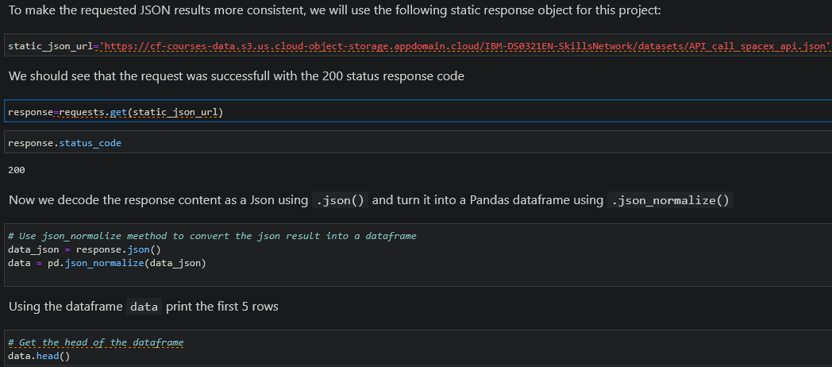
Data Collection – SpaceX API
Present your data collection with SpaceX REST calls using key phrases and flowcharts
https://github.com/Temp0-Sys/IBMDataScienceSpaceX/blob/main/jupyter-labs-spacex-data-collection-api.ipynb
Place your flowchart of SpaceX API calls here

Slide 9
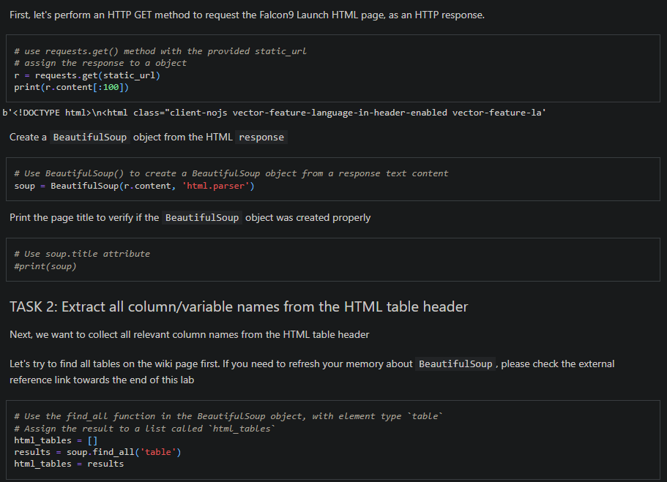
Data Collection - Scraping
Present your web scraping process using key phrases and flowcharts
https://github.com/Temp0-Sys/IBMDataScienceSpaceX/blob/main/jupyter-labs-webscraping.ipynb
Place your flowchart of web scraping here

Slide 10
Data Wrangling
We analyzed the data, and then calculated the number of launches at each site, and the orbit hey got to.
https://github.com/Temp0-Sys/IBMDataScienceSpaceX/blob/main/labs-jupyter-spacex-Data%20wrangling.ipynb

Slide 11
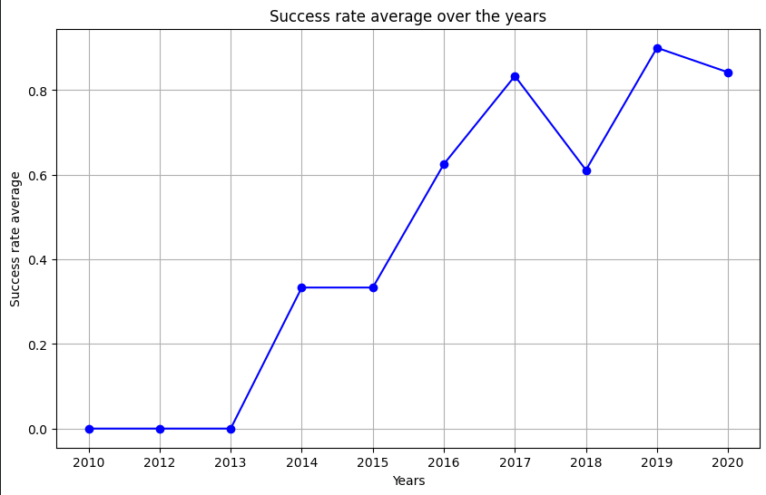
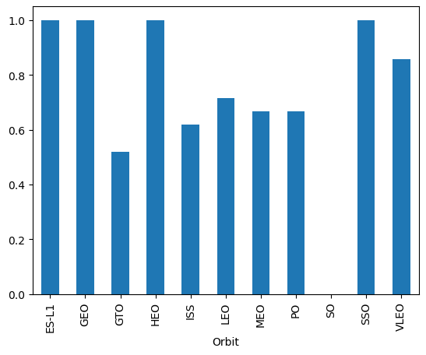
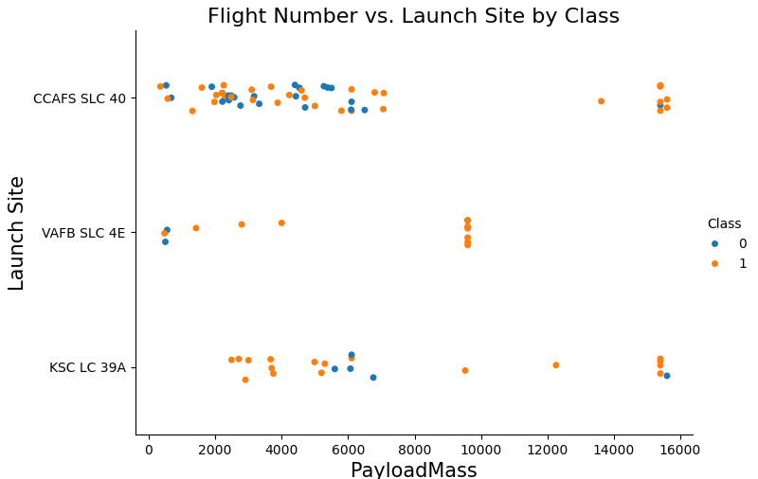
EDA with Data Visualization
We plotted many charts – one is the success rate by each orbit, and the second one is the average success rate over the years. Another type we used is scatter chart to see the effect of different features on one thing
https://github.com/Temp0-Sys/IBMDataScienceSpaceX/blob/main/edadataviz.ipynb

Slide 12
EDA with SQL
We performed the following queries in SQL:
The names of unique launch sites in the space mission.
The total payload mass carried by boosters launched by NASA (CRS)
The average payload mass carried by booster version F9 v1.1
The total number of successful and failure mission outcomes
The failed landing outcomes in drone ship, their booster version and launch site names.
https://github.com/Temp0-Sys/IBMDataScienceSpaceX/blob/main/jupyter-labs-eda-sql-coursera_sqllite.ipynb

Slide 13
Build an Interactive Map with Folium
We marked all launch sites, and added ways to mark the success or failure of launches for each site

Slide 14
Build a Dashboard with Plotly Dash
We built an interactive dashboard using Plotly Dash.
We plotted pie charts of the total launches by all the sites or each one
We plotted scatter graph showing the relationship with Outcome and Payload Mass (Kg) for the different booster version.
https://github.com/Temp0-Sys/IBMDataScienceSpaceX/blob/main/spacex-dash-app.py

Slide 15
Predictive Analysis (Classification)
First, we loaded all the data using numpy and pandas, did transformation over all of it and split into training and testing set.
We created various ML models and tuned different hyperparameters
We then checked the accuracy of each model to find the best performing model

Slide 16

Section 2

Slide 17
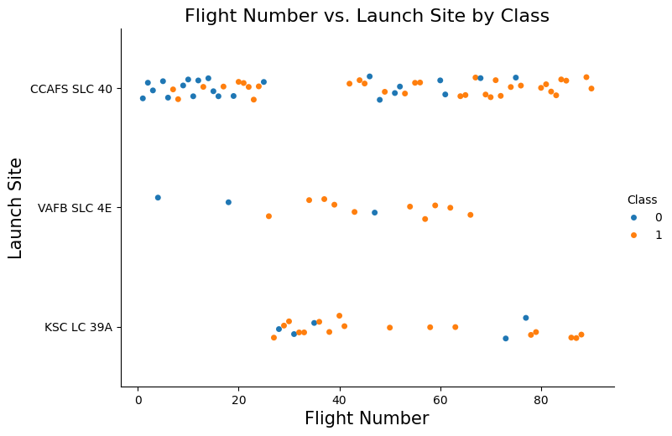
We can see here that the greater the number, the better the success rate is
Flight Number vs. Launch Site

Slide 18
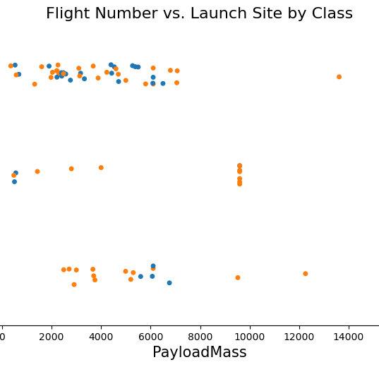
Payload vs. Launch Site
The greater the payload, the higher the success rate is
(Title is incorrect, forgot to update it)

Slide 19

Success Rate vs. Orbit Type
The orbit types that had the best success are ES-L1, GEO, HEO, SSO

Slide 20
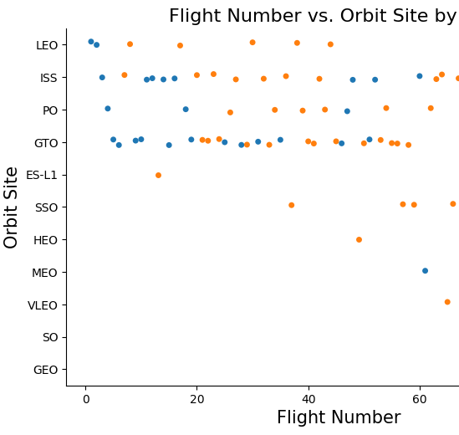
Flight Number vs. Orbit Type
From this plot, we can see that the more flight an Orbit site has, the better the success rate is.

Slide 21
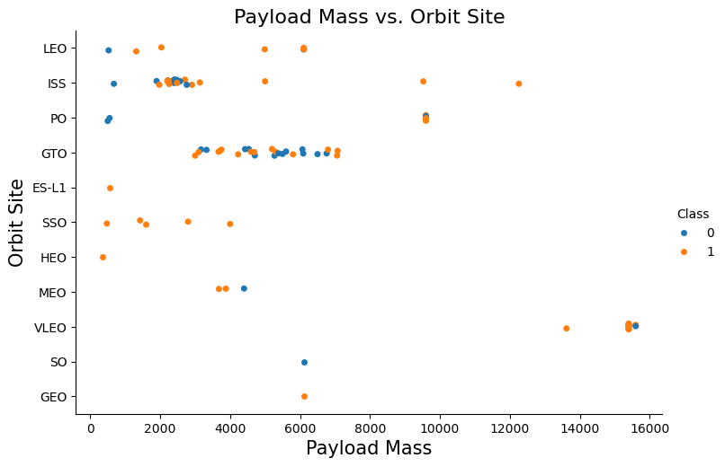
Payload vs. Orbit Type
From this plot, we can conclude that mostly when the payload is heavier, the higher the success rate it.

Slide 22
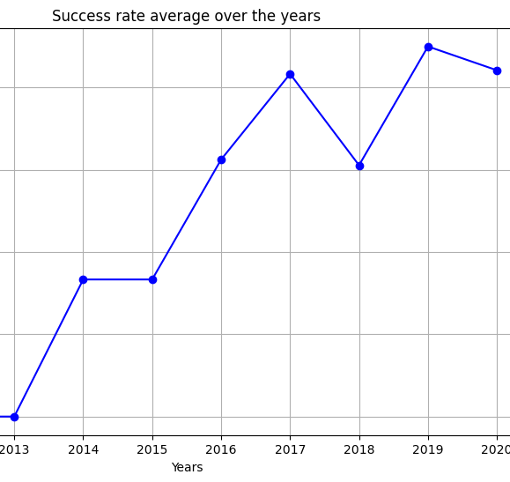
Launch Success Yearly Trend
This graph shows as that as time pass by, the average success rate is getting better and better, until around 2020.

Slide 23
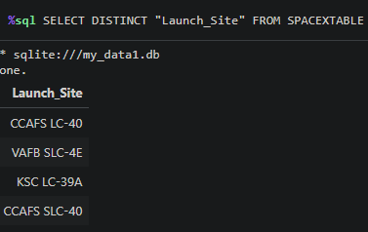
All Launch Site Names
Using the DISTINCT feature, we can find all the unique launch site names.

Slide 24
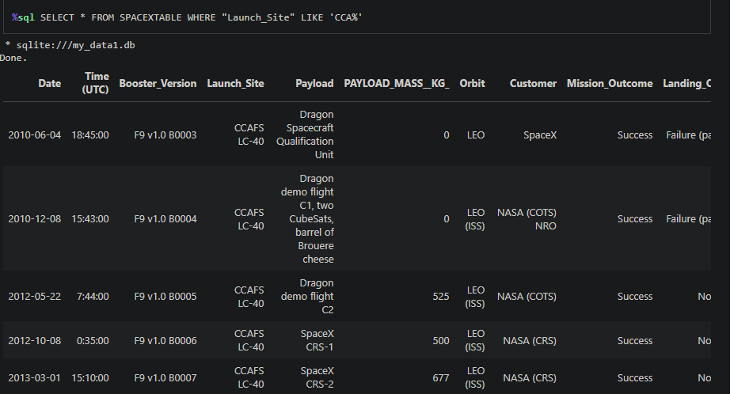
Launch Site Names Begin with 'CCA'
By using wildcard (%), we can get all the information that relevant that might include our word. By using LIMIT 5 (which not shown in the picture), we can limit the results to 5

Slide 25
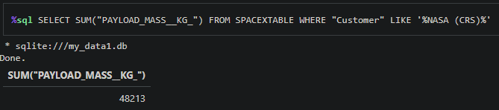
Total Payload Mass
Here, by summing the payload weight in each row that contains the customer name NASA (CRS), using the SUM function we can find the total weight.

Slide 26
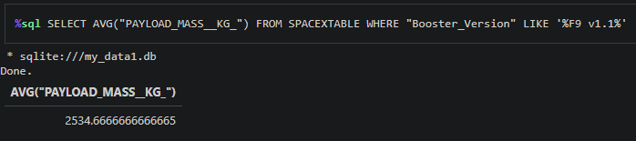
Average Payload Mass by F9 v1.1
By limiting the Booster_Version to %F9 v1.1% and using the AVG function, we can calculate the average.

Slide 27
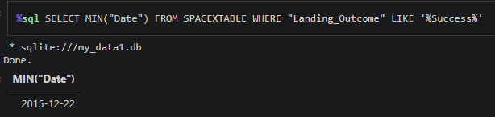
First Successful Ground Landing Date
By getting all the results that has “Success” in the landing outcome, and then using MIN function to select the smallest date, we can get our first successful landing.

Slide 28
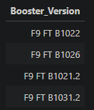
Successful Drone Ship Landing with Payload between 4000 and 6000
The query is very long:
%sql SELECT DISTINCT "Booster_Version" FROM SPACEXTABLE WHERE "Landing_Outcome" LIKE 'Success (drone ship)' AND PAYLOAD_MASS__KG_ > 4000 AND PAYLOAD_MASS__KG_ < 6000

Slide 29

Section 3

Slide 30
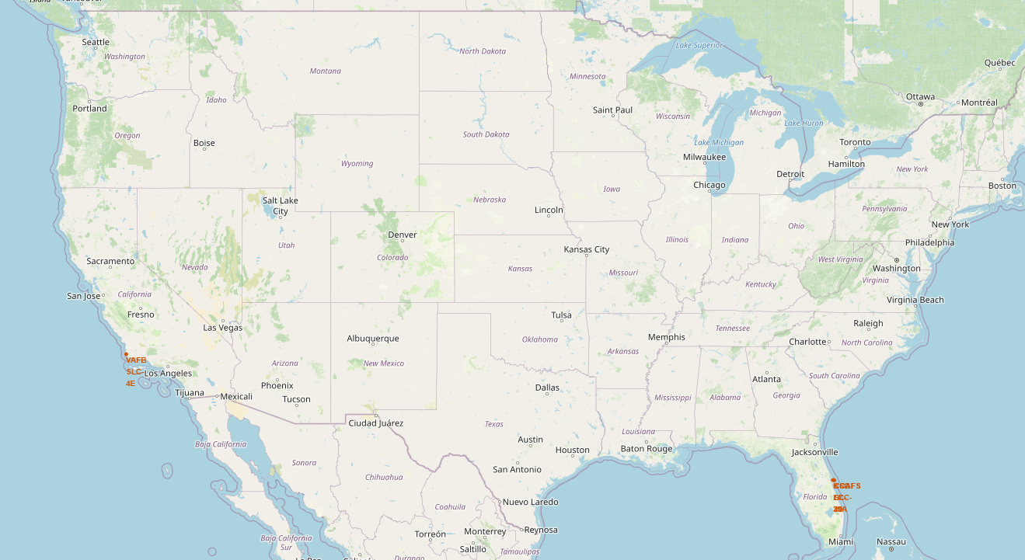
SpaceX Launch Sites Location
From this map, we can see that SpaceX is launching exclusively from the coasts in the USA, and only at the south.

Slide 31
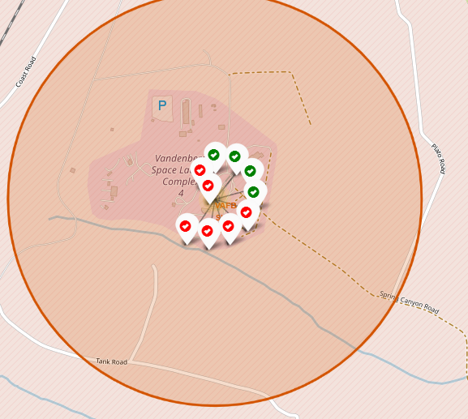
<Folium Map Screenshot 2>
From this picture, we can see the launch site in California. Green means successful launch while red shows failed ones. It seems that SpaceX doesn’t have much success launching from California.

Slide 32
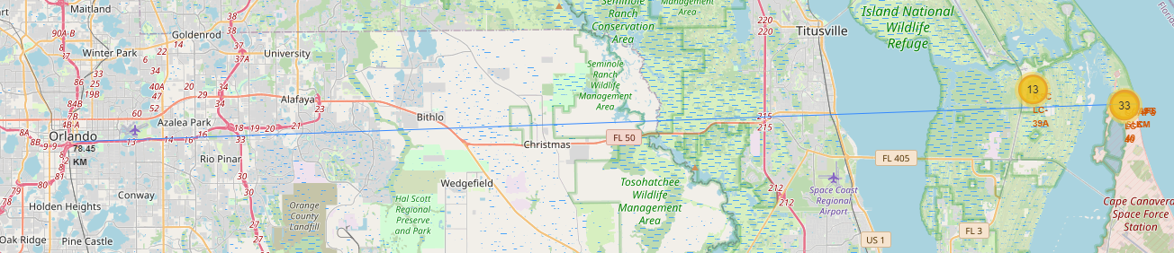
Distance between launch site and city center
In this map, we can see the distance between the launch site in Cape Canavera and Orlando

Slide 33

Section 4

Slide 34
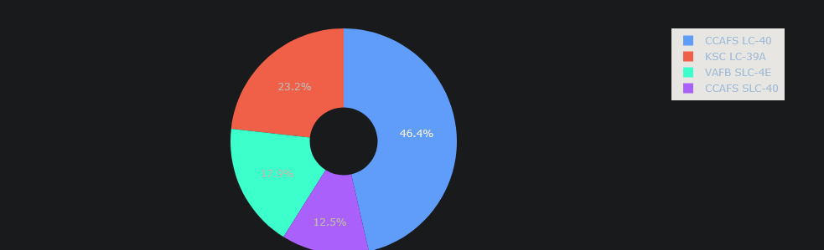
Total Success Launches By all sites
From this pie chart, we can see that CCAFS LC-40 is the most successful launch sites among all the sites, followd by KSC LC-39A by 23%

Slide 35
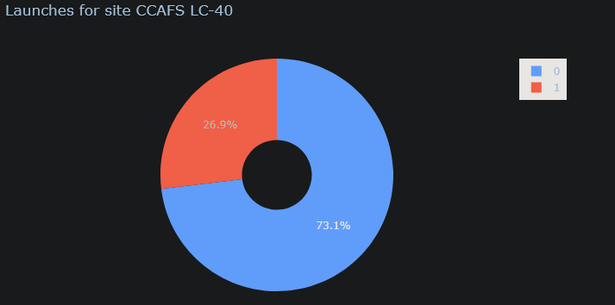
Launches for site CCAFS LC-40
Diving in to our most successful launch site, we can see that 73% of the launches are successful

Slide 36
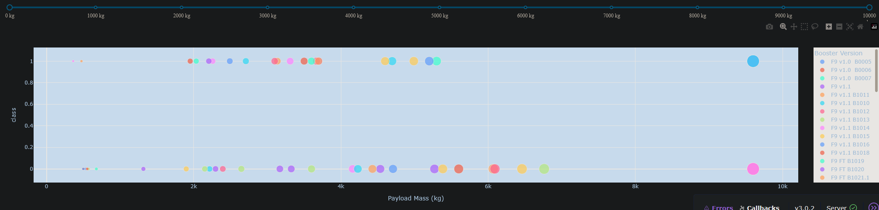
Launches across different payload weights
In this plot, we can see the distribution of the successful of launches across different weights.

Slide 37

Section 5

Slide 38
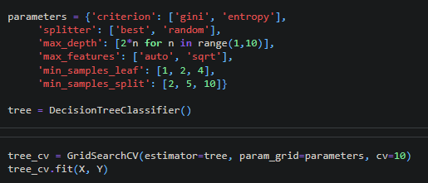
Classification Accuracy
Across all the models, decision tree is the model with the highest accuracy, standing on 87.77%.

Slide 39
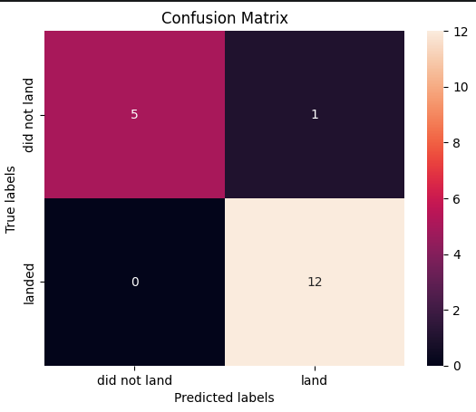
According to the confusion matrix, it seems that the model is doing a really good job predicting the landing, with both high false-negative and true-positive high which is great.
Confusion Matrix

Slide 40


